Slide 1
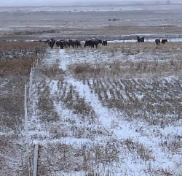
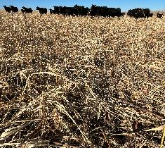
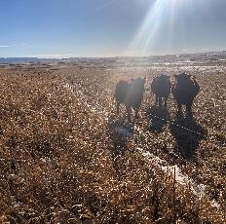
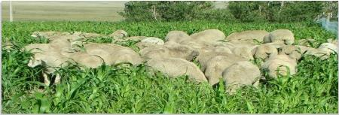
Module 8
Incorporating Grazing into Cover Crops and Annual Forage Systems
Notes:
Photos: Marlon Winger, Tanse Herrmann - NRCS

Slide 2
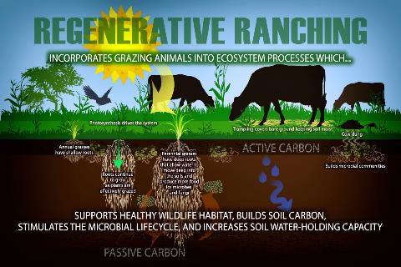
Objectives
Review advantages of grazed multispecies cover crops and challenges associated with grazing on cropland.
Review impacts to nutrient cycling and soil health that occurs when livestock are introduced into a cropland system
List and analyze several producer cover crop mixes used for grazing
Discuss economic benefits of grazing for crop producers and livestock owners
Identify infrastructure requirements for grazing use of cropland
Online: Tomkat Ranch

Slide 3
Review key points on covers/grazing from SHASFS
Advantages in the mind of the landowner:
Reduce or eliminate to need to feed harvested forages during winter
Part of a holistic grazing mgt plan for annual and perennial forages
Animal performance enhanced vs dry rangeland, calves have bloom (shiny)
More flexibility in selection of cover crops with various C:N ratios, when considering planting into that residue for the next cash crop
All cover crop grazing, managed appropriately, addresses all the SH principles (if you no till)
Biological acceleration, Nutrient cycling, Diversification of landscape
Notes:
Suggest having students list advantages that may be present in the mind of landowners THEN bring up the list to highlight others they may not have thought of.

Slide 4
Review key points on covers/grazing from SHASFS
Challenges in the mind of the landowner:
Lack of knowledge/familiarity about: Livestock management /infrastructure
  Equipment capability, making the mix, grazing of potentially poisonous plants
Risk of livestock escapes
Biological desert vs living landscape
Paradigm shift...
Landowner / Lessee agreements, cash rental rates for grazing
Herbicide restrictions, restrictions for grazing, long lasting chemical residue
Unknown benefits (SH, $, C, OM, diversity of enterprise, water use, social, knowledge, mentor, wildlife, overhead reductions, animal health, embrace the living landscape, weather resilience)
Notes:
Suggest having students list challenges that may be present in the mind of landowners THEN bring up the list to highlight others they may not have thought of.

Slide 5
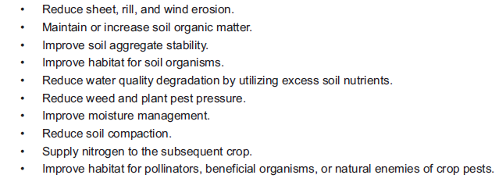


Comparing Purposes: Cover Crop (340)
340
Notes:
Some of the 340 purposes allow mechanical harvest or grazing and some DO NOT.

Slide 6
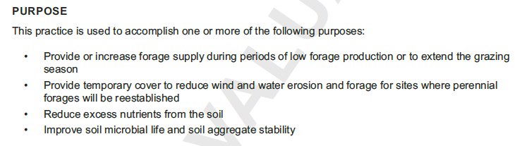


Comparing Purposes: Annual Forages for Grazing Systems (810)
810
Notes:
Some of the 340 purposes allow mechanical harvest or grazing and some DO NOT.

Slide 7
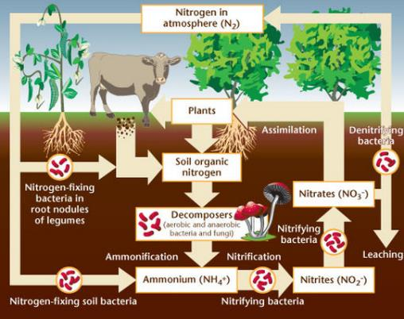
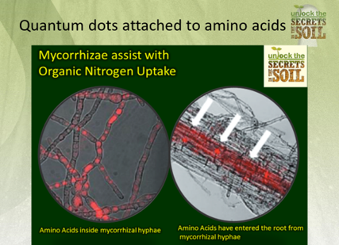
Effect of Grazing on Nitrogen Cycle
AMF
Notes:
Nitrogen cycle: Let’s look at the nitrogen cycle and the potential for manure to aid in the cycling of N. Nitrogen is broken down in manure from stable organic nitrogen (OM) to ammonium (mineralized), then to nitrates (nitrification). Increasing biological activity from manure organic matter increases uptake of nitrogen into the bodies of microbes. This stabilizes N and improves the cycling. So herbivores, plants and soil biology can work together so all can benefit.
Plants ALSO absorb organic forms of Nitrogen (amino acids, proteins) through (AMF) association.
Right slide notes: Scientists at the University of California, Irvine, recently discovered another source of NITROGEN uptake unique to mycorrhizal symbiosis. Using cutting-edge technology, nanometre-sized bits of semi-conducting material called quantum dots were attached to organic compounds such as nitrogen-laden amino acids.
For more than 100 years conventional scientific wisdom held that root absorption of nitrogen was restricted to inorganic forms of nitrogen such as N03, N02 and NH4. But to their surprise, the scientists saw the illuminated dots attached to amino acids enter the mycorrhizal hyphae and observed them as entire molecules moved into the root cell vacuoles and then continued systemically to the chloroplasts (in which nitrogen is used for photosynthesis).
In non-mycorrhizal rhizospheres, amino acids, which are the primary components of proteins, must undergo extensive and time-consuming decomposition processes by bacteria and other soil organisms before nitrogen is released in inorganic (NH4), plant-usable forms. Bacteria (Nitrosomonas/Nitrobacter) convert NH4 into NO3. In many cases, much of the nitrogen is consumed by the organisms, further delaying its plant availability.
This research demonstrates that mycorrhizal fungi allow their plant hosts to bypass this process, implementing quick and effective access to organic nitrogen sources. What this means to the farmer is that by utilizing mycorrhizal fungi, naturally-occurring and introduced sources of organic nitrogen (such as found in fish-based fertilizers, green manures and compost) can provide a readily available source of nitrogen to promote crop growth and enhance yields. In addition to phosphorus and nitrogen, the mass of hyphal filaments in the soil surrounding mycorrhizae-colonized roots is also capable of mobilizing an array of other important plant nutrients, including calcium, iron, magnesium and critical micro-nutrients such as manganese, zinc and copper. Just as a lack of vitamins can impair human or animal health, crop yields and forage production are sometimes limited by insufficient supplies of these minor- and micro-nutrients, even when N-P-K is abundant.
Mycorrhizae’s ubiquitous presence throughout the surrounding soil can access these relatively scarce resources and, in many cases, can release them from insoluble compounds via the production of specialized enzymes. The management of micro-nutrients is becoming increasingly recognized as an important component of modern cropping science. Mycorrhizal fungi can serve as useful tool to ensure that both natural and introduced sources of these nutrients are transferred efficiently from the soil to the plant.

Slide 8
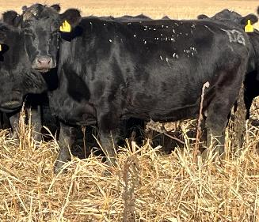
Impacts on soil health
Research grazing cover crops
  MN and IA: Increased fertility, total organic carbon, inorganic carbon, total carbon, and total living microbial biomass
  GA: grazing cover crops did not cause substantial physical damage to the soil; with no-till improved biologically active C and N fractions
  SD: Most soil health parameters improved or change only slightly, yields not impacted negatively
Research grazing crop residues
  IA in winter: utilizing corn stover as an inexpensive feed source is a viable option; posing minimal reductions to soybean yield
  NE in fall and spring: Long-term corn residue grazing had little to no effect on soil properties and did not affect crop yields
Tanse Herrmann - NRCS
Notes:
Williams, A., King, W., Spratt, E., 2018. Technical Bulletin: Benefits of planting and grazing diverse cover crops. Pasture Project.
Franzluebbers, A.J., Stuedemann, J., 2008. Soil physical responses to cattle grazing cover crops under conventional and no tillage in the Southern Piedmont USA. Soil and Tillage Research. 100, 141-153.
Clark, J.T., Russell, J.R., Karlen, D.L., Singleton, P.L., Busby, W.D., Peterson, B.C., 2004. Soil surface property and soybean yield response to corn stover grazing. Agronomy Journal. 96, 1364-1371.
Rakkar, M., Blanco-Canqui, H., Drijber, R., Drewnoski, M., Macdonald, J., Klopenstein, T., 2017. Impacts of cattle grazing of corn residues on soil properties after 16 years. Soil Science Society of America Journal. 81, 414-424.
Tobin, Colin, Shikha Singh, Sandeep Kumar, Ton Wang, Peter Sexton. 2020. Demonstrating short-term impacts of grazing and cover crops on soil health and economic benefits in an Integrated Crop-Livestock System in South Dakota. Open Journal of Soil Science. Vol. 10 No. 3(2020), 109-136.
Franzluebbers, A.J., Stuedemann, J.A. 2015. Does grazing of cover crops impact biologically active soil carbon and nitrogen fractions under inversion or no tillage management? Journal of Soil and Water Conservation. 70(6):365-373.

Slide 9

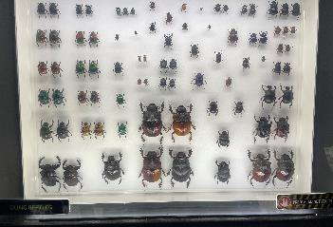
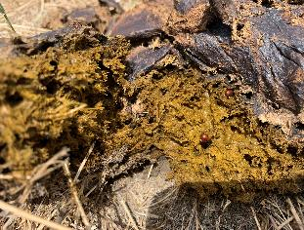
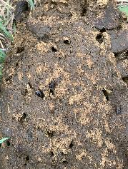
Dung Beetles, Accelerating Nutrient cycling and creating macro pores
Considerations:
Previous insecticide treatment(s) to the field.
Parasite treatment(s) to the livestock may be lethal to beneficial insects or sterilize reproductive ability.
Positive effects of having diverse insect life.
Rapid nutrient cycling for soil function---C:N reductions for the next biological consumer.
With ample biological diversity, there is little to NO WASTE in healthy ecosystems.
Tanse Herrmann - NRCS

Slide 10
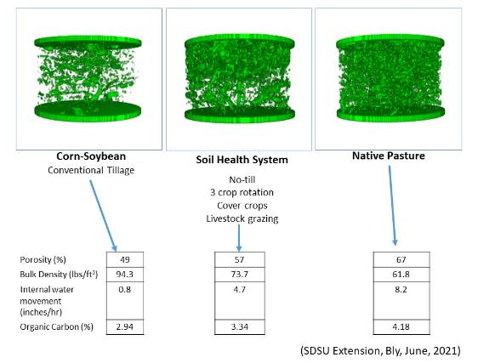
Management impact to soil structure & porosity

Slide 11
Objectives – planning considerations
Cool-season dominated mixes = quality, but production
Warm-season dominated mixes = quality, but production
  What animals will graze this cover crop/forage?
  When will animals utilize the growth?
  Opportunities to purchase stockers/yearlings?
  Cover Crop grazing – only for cattle?
Utilizing cover crops to reduce pressure on perennial forage – plan cover crop mixes for shortages (quality or quantity) in perennial system
Notes:
What class of livestock? Mature cows, steers, heifers, first-calf heifers
If you have younger animals, you’ll want to have them on a higher plain of nutrition, so there is an opportunity to run them through first if you have them split up into different herds.
One of the best strategies for drought management is having/buying stockers/yearlings to make up somewhere around 20-25% of the total herd (they can be more easily liquidated than the mature breeding animals). Utilizing cover crops with these animals is a great use of that resource, and in years when the cover crops are abundant, sometimes additional animals can be purchased to take advantage.
In some perennial systems, there is a mid-summer slump in the quality of the forage – cover crops may be able to bridge that gap between early summer and fall higher quality on perennial systems.

Slide 12
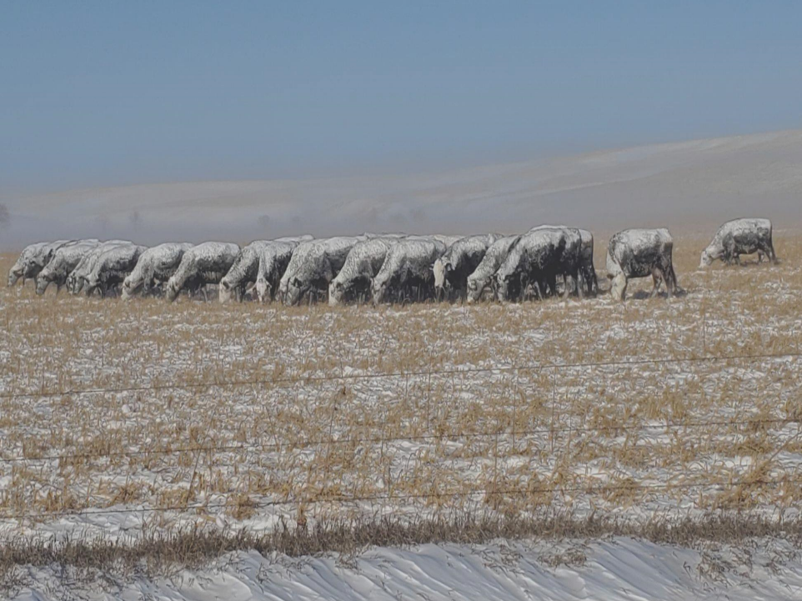
Objectives – planning considerations
Plant Perennials on the worst soils, crop the best.
  In some cases, the best approach may be to heal the land using multi-species cover crops, then plant perennials.
Consider using higher C:N ratio cover crop mixes that are more competitive, especially if weed pressure is a concern.
Fill perennial forage production/quality gaps with strategically planned cover crop mixtures on cropland
Grazing cover crops enables changing season of use on perennial forage systems to maximize diversity on those perennial acres.
Photo: Riley Kammerer, SD
Notes:
In this context, remediation means making good use of those “poor areas” where you typically will only get a good crop maybe 2-3 years out of 10. If you use cover crops on the rest of the field, planting these “poor areas” to adapted perennial grasses can provide a means for the cattle to balance their own diet better when being moved onto cover crops that are super high in quality. It has also been shown that it is more economical to not plant these “poor areas” to an annual crop every year because the money is wasted on these areas. A case study in South Dakota showed it was cheaper to plant these areas to perennial grass than it was to try and crop it each year.
Cattle manure C:N ratio is about 15:1; whereas, wheat straw is about 80:1 and vegetative rye cover crop is 26:1, so a grass cover crop that could typically tie up a lot of nitrogen can be converted to material much lower on the C:N ratio scale making the nitrogen much more available. So grazing adds flexibility when the main purpose is controlling weeds with dense grass cover crops.
Changing season of use on perennial grasslands is one of the best ways to maximize diversity on the grasslands. Having cover crops available at various times throughout the year can allow for more flexibility in when the perennial grasslands are used.

Slide 13
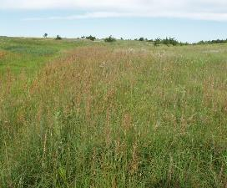
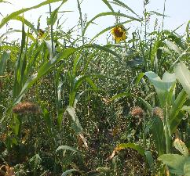
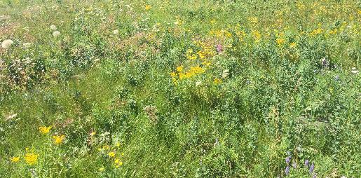
Objectives: species selection for diversity
Native Rangelands
Look to & mimic diversity on healthy native rangeland
Desired ecosystem services are usually delivered, even under adverse conditions, due to community dynamics
  Diverse diet selection
  quality forage throughout season-of-use
  weight gain
  animal health
Compounding positive effects of soil health principles improves ecosystem function
Native Rangeland
Notes:
As we know, this is related to one of the soil health principles, and most of this is covered in another module, but obviously more diversity above-ground relates to more diversity below-ground and a host of associated benefits because of that. But we have a few other advantages here related more to livestock integration.
When you think of diversity in your cover crops, Dwayne Beck likes to say think of a tallgrass prairie (pictured on the right). There is a variety of structures, seasons of growth, types of species, etc.
2+2 doesn't equal 4 when compounding soil health principles, one upon the other, and more!

Slide 14
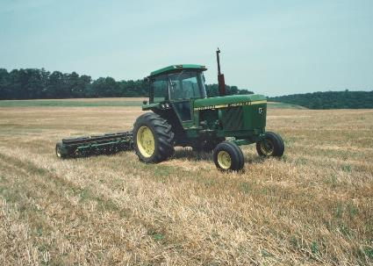
Objectives – timing of seeding/grazing
Spring seeded cover crops
  Late spring and/or summer
Summer seeded cover crops
  For fall/winter utilization
Full-season cover crops
  For use green and/or dormant (mature)
Fall seeded cover crops
  For spring grazing use
Gabe Brown: "I try and plant a cover crop before my cash crop, with my cash crop, or after the cash crop on all 2,000 acres"

Slide 15
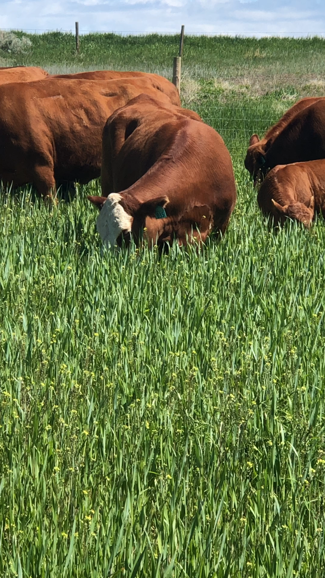
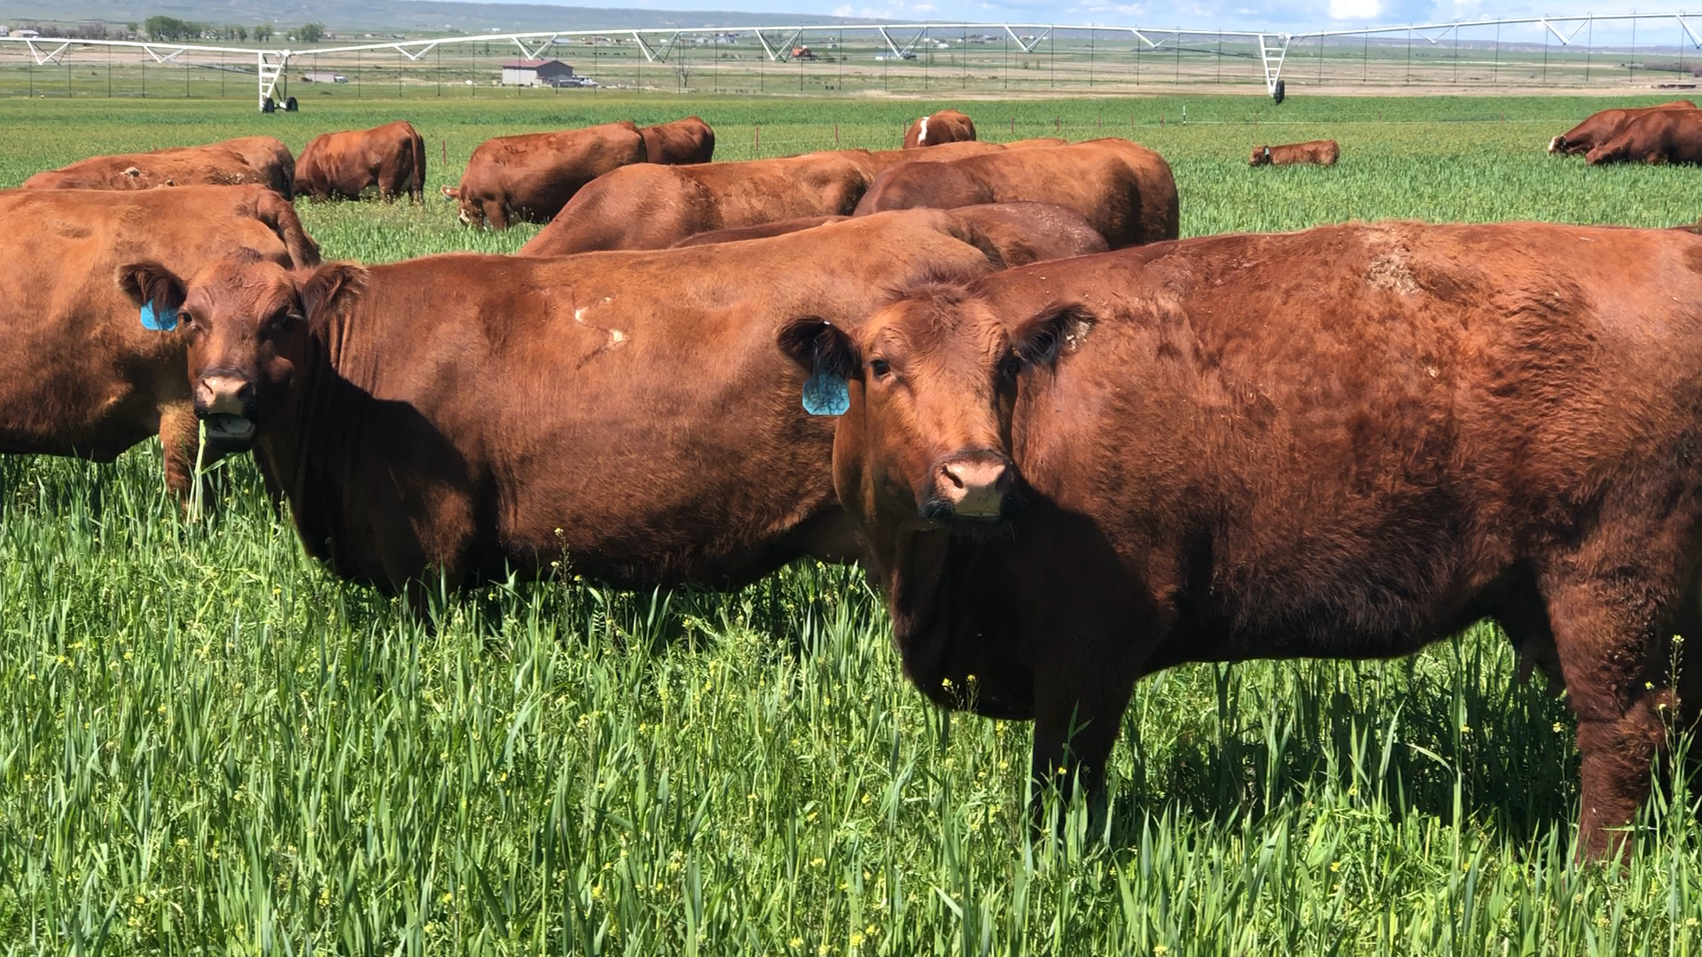
Objectives: timing of seeding/grazing
Fall-seeded
Following cash crops like corn for grain, silage corn, or early-harvested small grains
Cover crop planted immediately after harvest or inter-seeded before row crop reaches full maturity
Grazed in the Spring
What species will overwinter if planted September 10th in your county?
Marlon Winger - NRCS

Slide 16
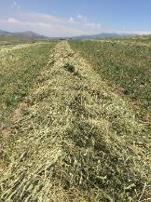
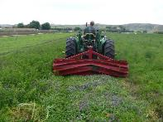
Objectives – timing of seeding/grazing
Fall-seeded
Fall seeded biennials – (west region)
Winter small grains (wheat, triticale, barley), hairy vetch, Faba bean, winter camelina, kale (Siberian or other), cereal rye, annual ryegrass
Options:
Hay in emergency (mine the nutrients) baled, silage
Drought plan to have winter forages planted
Combine for grain
Calve on the forage crop
Graze stockers / grass finishers
- bat latch gate openers for highest quality feed
Armor for bare soil (higher C:N ratio)
Notes:
Winter grains include wheat, barley triticale

Slide 17
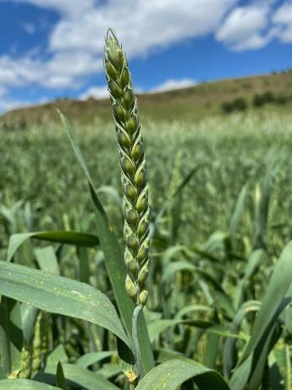
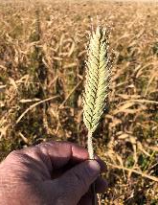
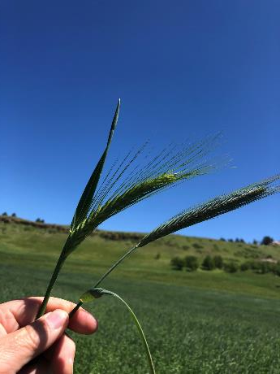
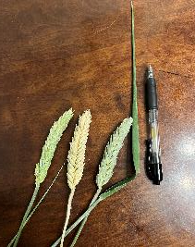
Awnletted Triticale
R
Beardless Triticale
Cereal Rye, Awns, 3.5” flag leaf
Forage type Ray winter wheat
No awns, 10.5” flag leaf
Photos: M. Winger
Notes:
There are better forage options than cereal rye, can use winter triticale, winter wheat or winter barley (in warmer regions)
Photos: M. Winger

Slide 18
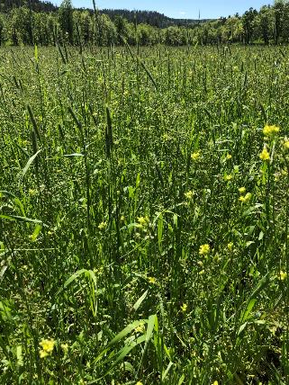
Winter Cover Crop Mix, Eastern Wyoming
Where will an overwintering cover crop mix
NOT work?
Cereal Rye 30 lbs /ac
Ray Winter Wheat 30 lbs /ac
Camelina .25 lbs/ac
Hairy Vetch 4 lbs /ac
Dryland 14-16 inches precipitation
Planted No Till, Sept 20
JD 1590 drill
Picture date: June 15, 2022
No fertilizer
Implementing all 5 SH principles
Burn-down herbicide (glyphosate) application prior to fall planting
Provides early spring grazing or hay
Nearly drought proof
What cover crops might overwinter in your service area?
Notes:
Record student responses to "what cover crops might overwinter in your service area" to inform Slide 22 ARS periodic table circled items.
How does a planner navigate a mix with rye in it where wheat is in the rotation?

Slide 19
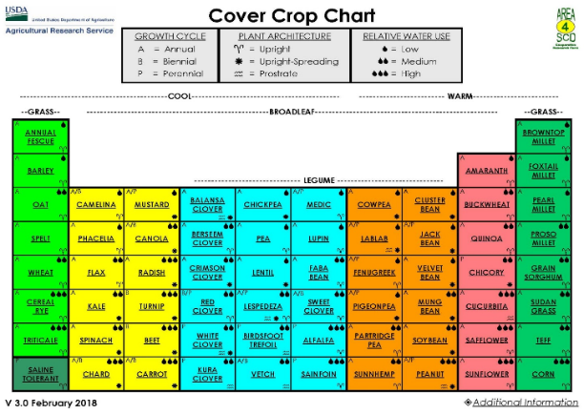
Objectives – timing of seeding/grazing
Fall-seeded
Notes:
The circled species here are ones that MAY overwinter in the Dakotas – if they will overwinter there, they will likely overwinter anywhere else. Obviously, the list gets longer as you get to warmer climates.
Winter cereal species are some of the best for this period. Be careful of some species like hairy vetch – it can persist in some cases and become a weed.

Slide 20
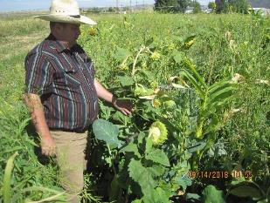
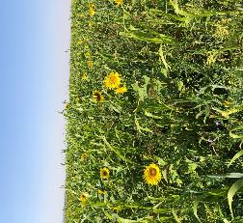
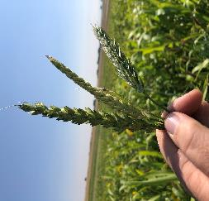
Objectives – timing of seeding/grazing
Full-season
Cover crop planted in lieu of long-season cash crop or fallow
Planted late Spring/early Summer
Graze in summer – in some cases may be hayed judiciously and graze the regrowth
What species (Functional groups) will grow if planted after final frost in your county?
Photos: M. Winger
13 way mix, WY
Beardless wheat, barley, triticale
Planted July 4, Multi species mix, Grace, ID
Notes:
All functional groups are available

Slide 21

Objectives – timing of seeding/grazing
Full season
Notes:
Full season planting opens up all cover crops in the mix

Slide 22
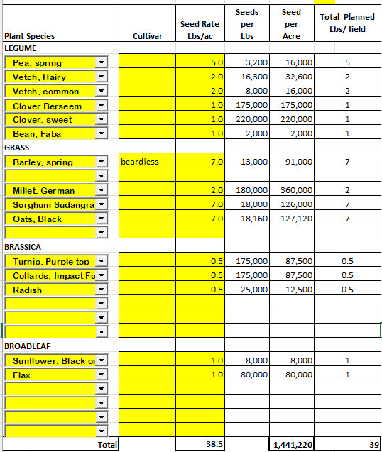
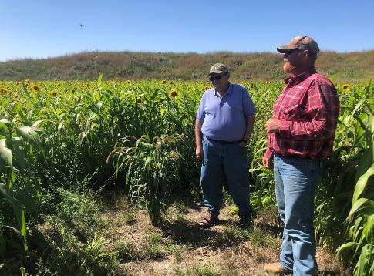
15-way cover crop mix for winter grazing, WY
Marlon Winger - NRCS
Notes:
Context: regenerating old smooth brome hayfield, by planting 15 way full season cover crop mix intended for winter grazing
Regenerating 250 acres of dryland hay 16” rainfall
No till drill
Weed sprayer
Sold hay equipment
Jake Bowller - Gillette, WY

Slide 23
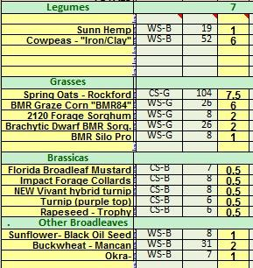
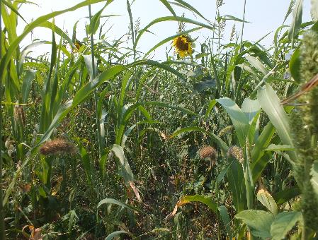

EXAMPLE WESTERN SD WINTER GRAZING MIX
Shawn Freeland, SD
32 lbs/acre seeding rate
Notes:
This is a producer-generated seed mixture, but he is a veteran cover cropper. He understands and believes that livestock grazing of annual & perennial forages is the way the heal his degraded soils after 100 years of mining soil nutrients via haying operations, severe & season-long grazing, and lack of any intentional fertility. Consider past use, planned cash crops, herbicide history, and always suggest inoculating any legume species!

Slide 24
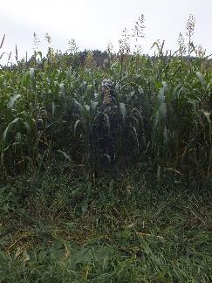
Objectives – timing of seeding/grazing
Summer-seeded
Following a short-season cash crop like (spring) wheat, barley, or oats (hay or grain):
Cover crop planted immediately after harvest
  More sunlight captured (Photosynthesis), primes the Carbon pump
Grazed late fall through winters end
  Reduced feed / hay cost
  Jerry Doan - ND from 5,000 to 600 bales of hay per year
  Riley Kammerer – SD from $700/day to $700/year hay costs
Can be windrowed late fall and grazed through winter to preserve forage quality
Select species that provide both: Energy & Protein
What species will grow if planted after local small grain harvest/silage chopping in your county?
Tanse Herrmann - NRCS
Notes:
Reduced hay & feeding expenses are result of grazing cover crop mixtures INSTEAD of daily hay feeding.
Can you find Valerie standing inside that cover?
Cover Crops Grown Post-Wheat for Forage Under Dryland Conditions in the High Plains. Kansas State University Agricultural Experiment Station and Cooperative Extension Service. June 2020.
https://www.morton.k-state.edu/crops-livestock/uploads/GrazingSummerCoverCrops.pdf

Slide 25
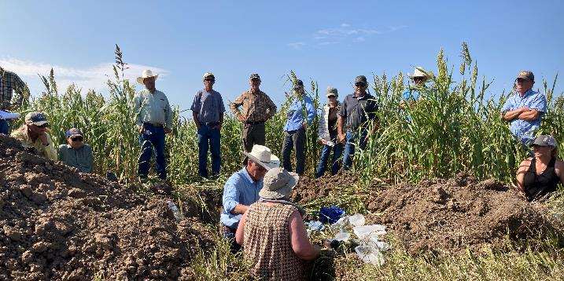
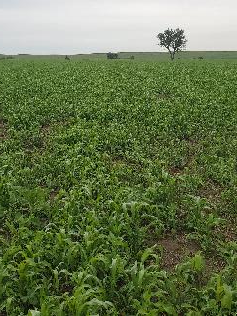
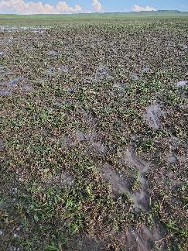
Renovating dryland hay using multi-species covers & grazing South Dakota CIG Case Study, 2023
August 23, 2023 – Recovered to almost 16,000 lbs/acre production!
June 26, 2023
June 27, 2023 After Hail
2021 Production: 1,383 lbs/acre
2022 Production: 5,756 lbs/acre
2023 Production: 15,740 lbs/acre
Photos: Riley Kammerer, SD
Notes:
2021: Very dry year – Year 1: total production was about the same as the worn out hayfield it replaced (1,500 lbs/acre annual average hay yield)
2022: Normal year – Year 2: 4X forage production vs average hay yield
2023: Normal spring then dry – Year 3: Almost 10X forage production vs average hay yield! The accumulating effects of improved soil health cannot be overstated! This doesn't make sense in human terms, but it is happening on the landscape! This is due to the compounding effects of maximized photosynthesis and embracing biological life.

Slide 26
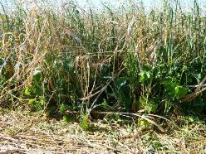
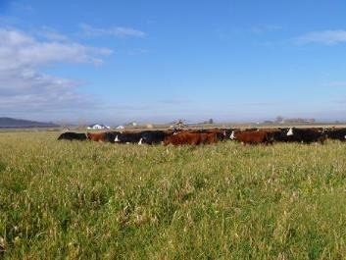
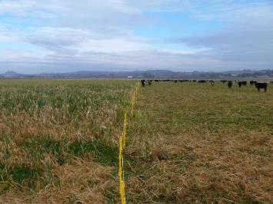
Brad McIntyre, Boise, ID
300 head of wild mother cows
3 acres per day
Stock density: ~106,000 lbs / acre
Previous crop: Irrigated winter wheat
Cover crop planted August 5. 13,000 lbs cover crop
Planned crop:
2014 Irrigated grain corn -274 bu /ac
  Idaho no-till record
Notes:
Photos by Marlon Winger, on Brad McIntyre farm, Caldwell Idaho
Termination method was cattle grazing, It is important to group livestock so the manure and urine will prime the biological life in the soil. This producer grazed 300 cows on 3 acres for one day.
Set up single wire electric fence to increase management

Slide 27
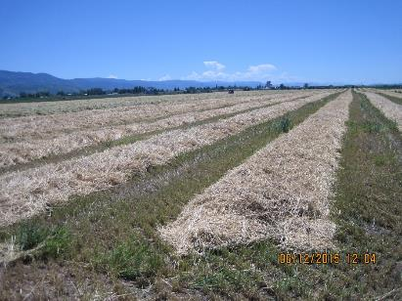

3 way winter grain mix cut for hay followed by no till 10 way full season cover crop mix. Cameron Williams, Grace, Idaho
Cameron Williams - NRCS
J. Clapperton: “Every type of plant exudes substances from its roots that attract specific microorganisms. The more diverse the community, the more extensive will be its services.”
Notes:
Producer cameron williams, planted 3 way winter grains, and use to then fallow the field until fall time, but now no till multispecies mix July 4th and winter grazes

Slide 28
Timing – Fall-seeded
Notes:
We have all seen the ARS periodic table, Marlon Winger modified it and developed a western states version of it that several states now use
Two functional groups?
4 functional groups?
6 functional groups?
Are you a lumper or splitter,
Plant species richness was found to have strong positive effects on soil aggregate stability and the presence of certain species of grasses and legumes, and their root traits, was
found to strongly influence soil physical properties of grass land in contrasting and potentially complementary ways.

Slide 29
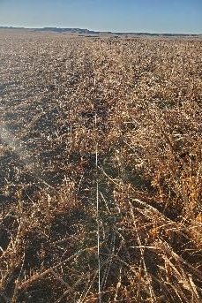
Vegetative management guided by Grazing Management CPS (528)
Key purposes:
  Increase or improve vegetation structure, vigor, and quantity/quality of forage.
  Enhance water quality/quantity; reduce soil erosion and maintain or improve soil health.
  Improve quantity, quality, connectivity of food/cover for wildlife;
Key strategies:
  Manage utilization to desired levels to improve desirable cover.
  Control frequency, timing, and duration to achieve desired outcomes.
  Plan grazing to match forage quantity/quality to animal requirements.
Tanse Herrmann - NRCS
Notes:
Many of the purposes and strategies utilized with Prescribed Grazing on grasslands can (AND SHOULD) be applied when grazing cover crops as well.

Slide 30
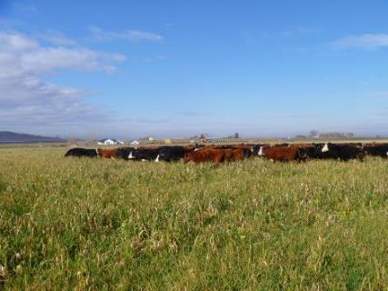

300 head of wild mother cows on 3 acres per day
Stock density: ~106,000 lbs / acre
Previous crop: winter wheat
Planned crop in spring: grain corn
M. Winger - NRCS
Notes:
McIntyre Farm, Boise Idaho, showing grazing of cattle, using a one wire poly string, and livestock moved daily, notice the armor on the soil surface.

Slide 31
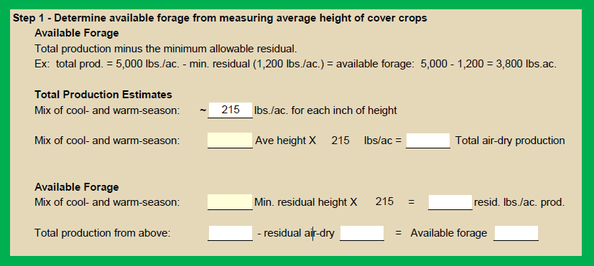
Determining total production
Reference: Soil Health Technical Note on Cover Crop & Crop Aftermath Grazing, 2025.
Notes:
This activity (hard-copy paper OR phone app) will be completed in the field on Day 2.
Suggest having hard copies of this calculator on-hand and do field measurements to inform the blanks on the forms. Also suggest (especially in further western states) calibrating the pounds per inch by measuring height (grazing stick) AND clipping to determine that day's productivity with an on-site known value in pounds per inch of height.
This comes from the Grazing Cover Crop Technical Note that will be published in the near future.
This method of determining the total and available production is based on a height/weight relationship method. The 215 lbs/inch of height can be adjusted based on local climate and conditions. Basically use a yard stick or grazing stick to get a rough idea of average height of vegetation. Do not measure height of seed heads extending up beyond the vegetation, but the actual average vegetation height.
After total air-dry production is calculated, Available Forage is determined. Put in a minimum residual height for the cover crop based on management objectives, multiply by same lbs./inch value, then subtract this amount from the total air-dry production. The remainder will be the available forage.

Slide 32
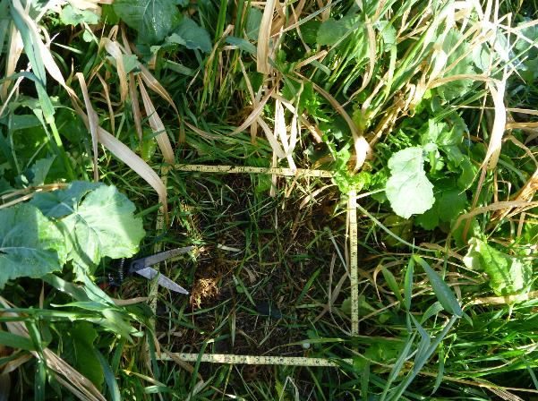
Determining total production
Preferred method for determining total air-dry production – clipping
  Use 0.96 sq. ft. or 1.92 sq. ft. frame, clip all forage to ground level
  Weigh forage in grams
  Multiply times factor (100 for 0.96 sq. ft.; 50 for 1.92 sq. ft.)
  Multiply times a dry weight factor (e.g., 30% if green; 80+% if dry)
  This value should be close to total air-dry production – clip a few frames to get a representative value
Subtract out a residual amount to leave – likely from 1,500 lbs. to 3,000 lbs. or more – result will be the Available Forage as in the previous slide
Notes:
The dry weight percentage can vary a lot more, but these ball-park numbers should be a decent starting place. Really green forage may only be 30% air-dry, and brown standing forage may be 80% or higher.
If you are not well-experienced with clipping to determine total production, highly suggest working with someone who does have that experience! More repititions ensure higher accuracy. :)

Slide 33
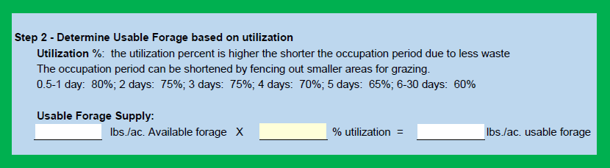
Determining target utilization
Reference: Soil Health Technical Note on Cover Crop & Crop Aftermath Grazing, 2025.
Notes:
Don’t think of this as a true “utilization” level number, this is just an efficiency factor based on the length of the grazing period, and it already takes into account the residual you left in step 1.

Slide 34
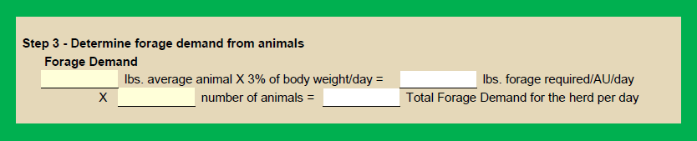
Determining grazing demand
Reference: Soil Health Technical Note on Cover Crop & Crop Aftermath Grazing, 2025.

Slide 35

Determining grazing numbers (days or acres)
Reference: Soil Health Technical Note on Cover Crop & Crop Aftermath Grazing, 2025.
Notes:
This last step assumes you already know the number of animals, and you need to determine the number of days, or the number of acres.
Use the number of days calculation if you have a fixed area you know you want to graze, and you don’t really plan on subdividing it much.
Use the number of acres calculation if you want to decide how long your occupation period will be, and you need to know how big the paddocks will be, like with strip grazing.

Slide 36

Determining grazing numbers (days or acres)
Reference: Soil Health Technical Note on Cover Crop & Crop Aftermath Grazing, 2025.
Notes:
So this is an example of just the last step (32 inch total height; 8 inch residual, 70% utilization; 200 – 1,350 lb. animals). They had 3,612 lbs./acre of usable, air-dry forage. They have a 40 acre parcel to graze. Based on the production and animal demand, they could graze that 40 acres for 18 days.
But they didn’t want to graze that long but preferred to divide it up. Based on their management, they could move every 5 days. So to move every 5 days, they would need to have paddocks that are 11.2 acres in size. This is about a ¼ of the 40 acres (if they had said 4 day occupations, it would have come out to 9 acres or a little less than ¼ of the total, so close to 4 even paddocks).

Slide 37

Planning for Armor/Residue/Cover
“Those that leave it, get it.” Keith Hire, Wyoming
Properly managed grazing of a cover crop can be a win-win for the soil ecosystem & livestock.
DO NOT REMOVE too much of the cover crop
  Overgrazing is akin to haying where 80+ % of biomass is removed.
Invest in nature generously → give back more than what we take.
100% cover is ideal, but may not be possible if cover crop is planted late summer following small grain harvest
  Consider C:N ratios, growth stage, & rate of decomposition.
The lower the yield, the greater the proportion that needs to remain as residue and the less that should be allocated for livestock.
Photo: Marlon Winger - NRCS
Notes:
The drier the environment, the more important it is to leave lots of armor to protect & feed the soil. This is not a license for wetter or irrigated lands to take everything, rather it is a warning that damage in more brittle/fragile environments tends to take longer to heal.

Slide 38


Planning for Armor/Residue/Cover
Percent Cover | Corn, Sorghum | Soybean, Small Grains | Diverse Cover Crop Mix*
 | Residue (lbs/ac)
30 | 1,000 | 530 | 765
40 | 1,450 | 800 | 1,125
50 | 2,000 | 1,200 | 1,600
60 | 2,650 | 1,650 | 2,150
70 | 3,500 | 2,150 | 2,825
80 | 4,700 | 2,800 | 3,750
90 | 6,700 | 4,000 | 5,350
100 | >8,000 | 7,250 | 7,625
Mid range C:N ratio mixture
100% Armor Post-Graze
Marlon Winger -NRCS
High C:N ratio mixture
100% Armor Post-Graze
Tanse Herrmann - NRCS
*Values based on average of middle two columns
Notes:
Keep in mind, this table shows potential lbs./acre of residue amounts that would be present with various amounts of residue cover. This does not necessarily mean that we want all the residue we leave behind to be laying on the ground. There are advantages to leave standing residual biomass after a grazing event as well. The best end result would be a mix of standing residual and residue on the ground surface.
This table shows the amount of residue from certain crops based on a specific cover percentage. Percent cover begins at 30% because that is the minimum from a residue compliance standpoint. While the percent residue cover to residue weight values have been measured for corn, sorghum, soybean and small grains, we don’t have measured values for a diverse cover crop mix containing multiple species from three or four functional groups. To create values for the diverse mix column, the values in the middle two columns were averaged.
Starting at 30% ground cover, residue for the diverse mix is 765 lbs/ac. But at 30% residue cover, what’s on the other 70%? The answer is nothing! Because of that, 30% residue cover shouldn’t be the minimum. If we’re serious about improving soil health, then more residue cover is needed. A better residue cover percentage minimum that provides more soil cover with good grazing management is 50% which is nearly twice as much as 30%. If we use 50% cover as the minimum for a diverse mix, then 1,600 lbs/ac is needed after livestock leave the cover crop.
Source: Corn and Soybeans Crop Residue Management Guide, Natural Resources Conservation Service
https://efotg.sc.egov.usda.gov/references/public/WA/A.12_Corn&SoybeanCrop_ResidueManagementGuide.pdf

Slide 39




Maximizing soil ARMOR – LEAVE PLENTY BEHIND!
"DON'T LEAVE YOUR SOIL NAKED, HUNGRY, THIRSTY, & RUNNING A FEVER!" R. Archuleta
Tanse Herrmann, USDA-NRCS
Marlon Winger -NRCS
Winecup Gamble Ranch, NV
Notes:
After grazing, a good mix of residue trampled to the ground and standing residual biomass is ideal
Residue in contact with the soil surface provides physical and thermal protection to keep soil in place, protect surface aggregate structure, minimize compacting effect from livestock hooves, provide food and habitat for soil organisms, keep soil temperatures moderated, reduce evaporation
Standing residual biomass provide cover/shelter for animals, habitat for some birds and insects, and provides for greater obstruction of wind and more snow catch
Even manure/urine distribution over entire field
Reduces excessive nutrients near water/mineral locations
Provides more even growth of the next cash crop

Slide 40

Impacts on animal health
Rapid changes in diet quality can negatively impact short-term weight gains
Potential toxins resulting from monoculture cover crops:
  Nitrates – sorghum, sorghum-sudan, corn, brassicas
  Prussic acid – sorghum, sorghum-sudan
  Saponins – legumes such as alfalfa and clovers
  “Wheat bloat” – rapidly growing cereal grains
  Brassicas – several health issues
Diverse mixes and balancing the diet
If diverse mixes, livestock can self regulate
Notes:
First, generally speaking grazing of cover crops is a very positive thing for animal production/health, however…
Rapid changes in diet quality can negatively impact short-term weight gains because the rumen microflora have not had time to adjust to the new balance between energy and protein in the diet. Gradually introduce animals into the higher quality forage to reduce animal digestion problems and potential weight loss and illness.
Nitrates at high levels can cause difficulty breathing, staggering, and death (ammonium builds up in the blood and interferes with hemoglobin). Can happen with rapid increases in nitrates, as after a drought-ending rain, or after a frost – avoid grazing for five days after these kind of events. Nitrates tend to accumulate in the stems of grasses, so rotational grazing reduces the risk.
Prussic acid is a toxin that develops in new leaf material after the plant is stressed, as after rapid growth after a drought, or after a frost. Sorghum and sorghum-sudangrass are the biggest culprits. The BMR varieties are less susceptible to development of prussic acid.
Saponins are a chemical contained in some high-quality legumes such as alfalfa and white clover. Best prevention is by dilution, including a lot of varieties of types of species in the mix. Bloat blocks may be another option, or providing high fiber/low protein forages like straw, millet hulls, etc.
“Wheat bloat” is bloat caused by rapidly growing cereal grains in the spring. Limiting intake of susceptible animals is the best solution, or limiting intake through intensive management.
Brassicas can cause several disorders including polioencephalomalcia, hemolytic anemia (mainly with kale), pulmonary emphysema, nitrate poisoning, bloat, and metabolic problems (glucosinolates). Limiting the cover crop mix to 75% or less of the brassicas in the mix should greatly reduce the risk of these disorders from developing. Generally making mixes 50% or greater grasses will reduce most issues. If grazing a mix heavy with brassicas: 1) introduce animals slowly, 2) do not turn hungry animals into a brassica dominated stand, feed 2 to 3 pounds of hay or straw per animal each day, and 3) limit brassicas to 75% or less of mix.
The best solution for all of these issues is by 1) having a diverse mix of cover crop types, and 2) balancing the diet by providing other feedstuffs or feeding opportunities, like medium quality hay or making pasture available while on cover crops. Planting poorer areas into perennial grasses within the crop field is another way to allow the animals to balance their own diet. Cover crop mixes dominated by grass species is usually the best option for grazing ruminants.
Above information from Forage Brassicas for Winter Grazing Systems, Mississippi State University Extension, Publication Number: P2845

Slide 41





OTI = Opportunity To Improve
YOU CANNOT
REGENERATE YOUR SOIL WITH BARE GROUND!
Marlon Winger & Tanse Herrmann - NRCS
Notes:
opportunity to improve in our precious cropland, showing tillage and over grazing
What do you see?
What principle of SH is not being implemented

Slide 42

Livestock Requirements
Adequate water – water intake is directly linked to feed intake so it is critical to supply adequate, clean water.
High quality forage
  Primary metabolites – protein and energy.
  Plant secondary metabolites – beneficial for animal health.
Sufficient quantity forage
  At low levels of forage quantity, it will become increasingly challenging to provide sufficient dry matter for animal performance.

Slide 43

This varies with Breed and Environmental Conditions.
Check your state Extension Service for values more suited to your location.
Notes:
In range science, we agree that a mature 1,000 pound beef cow need 912 pounds of dry matter forage intake per month (presuming adequate quality – protein/energy). That 1,000 pound animal's forage requirement for 30 days equals 1 animal unit month (AUM). To put that in terms as this chart shows, 912 pounds/30 days=30.4 pounds per day (for 1,000 pound animals). 1200 pounds = 1.15-1.2 AU and 1400 pounds = 1.3-1.4 AU. The math doesn't correlate in a straight line as animal weight increases, but suffice it to say that larger animals require more groceries than smaller ones! Not only do they require more volume of feed, they need more of the crude protein and energy.

Slide 44

Impacts on animal health – diet quality – DOM/CP ratio
TDN/1.05 = DOM
Divide DOM by CP to get a value that ranges from 0 to more than 8 or higher.
DOM/CP ratio is an indicator of rumen efficiency:
<4 = Too high of quality (protein too high resulting in BUN and MUN). Usually happens on very lush, cool season or early spring pastures. Manure consistency is very runny.
4 – 7 = Acceptable with 4 being the optimal (livestock will gain the most weight). Most warm season and native range grazing has a range of 5 to 6.
>7 = Too low of quality (protein is too low and energy is too high). Late summer or drought stressed forage, some stockpiled grasses, and very mature, dry grass.
Marlon Winger - NRCS
Notes:
Total Digestible Nutrients
Digestible Organic Matter
Crude Protein
For a more definitive determination of diet quality, a forage quality analysis of the standing forage can give you a really good gauge of likely animal performance. Most forage quality tests will list TDN – to do this analysis you need to convert TDN to DOM. Divide TDN by 1.05 to get a rough value on DOM. Then divide the DOM value by the crude protein (CP) value to arrive at the ratio. The researcher who came up with this information, Dr. Jerry Steuth, said that this can range up to a value of 8 with the animals still gaining some weight, so a range of 4-8 is likely acceptable. Also, generally speaking, a CP value of less than 7 will often result in cattle not gaining weight, but it also depends on the energy (DOM) levels in the feed.
BUN and MUN stands for blood urea nitrogen and milk urea nitrogen which means there is excess nitrogen in the blood and milk, causing the animal to use resources to excrete the excess amounts. These can also interfere with the uterine environment and reduce fertility, and can interfere with hemoglobin and increase the risk of anemia.
Source: Result Demonstration Report – 2013 Nutritional Balance Analyzer (NUTBAL) Demonstration, Texas A&M AgriLife Extension
https://agrilife.org/westresults/files/2013/03/2013-Nutritional-Balance-Analyzer-Demonstration_Sterling-County.pdf

Slide 45



Cover Crop Feed and Forage Report
Menoken Farms, Bismarck, ND – Jay Fuhrer, Sept 16
Marlon Winger - NRCS
Species | Crude Protein | RFV | TDN
Annual Ryegrass - Top/half | 15.67% | 110.81 | 61.88%
Annual Ryegrass - Bottom/half | 8.02% | 109.05 | 60.12%
Cowpea - Top/half | 14.79% | 218.90 | 69.38%
Cowpea -Bottom/half | 4.35% | 103.72 | 58.94%
Hairy Vetch - Top/half | 14.75% | 126.74 | 60.78%
Hairy Vetch - Bottom/half | 6.07% | 85.59 | 52.08%
Pearl Millet - Top/half | 9.77% | 83.95 | 59.18%
Pearl Millet - Bottom/half | 1.77% | 86.91 | 57.79%
Radish - Top/half | 10.74% | 105.20 | 56.08%
Radish - Bottom/half | 6.54% | 75.30 | 48.09%
Soybean - Top/half | 17.90% | 190.15 | 67.95%
Soybean - Bottom/half | 11.76% | 114.08 | 59.10%
Sudan - Top/half | 7.83% | 83.93 | 58.21%
Sudan - Bottom/half | 7.52% | 84.78 | 57.56%
Sunflower - Top/half | 10.38% | 193.66 | 65.57%
Sunflower - Bottom/half | 6.06% | 123.83 | 58.30%
Sweet clover - Top/half | 24.53% | 228.51 | 72.25%
Sweet clover - Bottom/half | 12.62% | 97.47 | 55.15%
Notes:
Dairyland inc did feed analysis
Relative feed value, RFV = 150 is dairy quality hay, 100 = full bloom alfalfa
The bottom half of these species are all significantly lower quality than the top ½ of growth therefore animal performance will be significantly better if feeding the critter tops and the soil bottoms.

Slide 46



Impacts on animal health – diet quality
Consistency of manure can be used to gauge diet quality:
>20% CP; >68% TDN
12-15% CP; 62-70% TDN
<6% CP; <55% TDN
Cow Poop Analyzer app
Notes:
Which of these pats is showing (related to animal maintenance requirements) a) too much protein/energy b) too little protein/energy and c) the Goldilocks effect---JUST RIGHT?
Source: Noble Research Institute, Manure scoring determines supplementation needs, by Robert Wells, PhD (from their web page)
Note that it takes from 1-3 days for the consumed feed to pass all the way through, so what you’re seeing today could have been from their meal as much as three days ago. It passes more quickly the higher the quality of the forage.

Slide 47
Grazing Cover Crops in the West
Video Resources for Advanced Learning
NRCS Soil Health Workshop: Jerry Doan - YouTube - Jerry Doan, ND
"Long Live the Soil" - Jimmy Emmons -Jimmy Emmons, OK
GFE 2016 - Gabe Brown "Cover Crops for Grazing" - Gabe Brown, ND
Cover crops on dryland wheat? Challenge accepted. - Noah Williams, OR
Grazed Cover Cropping--Drew Leitch - ID
Joe Brummer Colorado State University Integrating Livestock with Cover Crops for Forage - CO
Cattle on Crop Economics - Soil Health Case Study - Jorgensen Land & Cattle, SD
Dung Beetle Video

Slide 48






5th Principle – Implemented: Incorporate Livestock!
Marlon Winger -NRCS
NRCS South Dakota
Notes:
Adaptive managing of cover crops can look different depending of the context of the operation, These are examples of grazing cove crop mixes during late fall to winter. These examples also show grazing intensity utilizing electric fence.
a) operation economics
c) graz

Slide 49
Participant grazing activity: Tanse demo
Twine string to represent the boundary of grazing field or paddock.
Mixed bag of candy which represents the forage mixture.
Notes:
This activity concept is to help students connect to the value of creating a high density/short duration grazing scenario versus long graze periods with high animal selection capability.
Build two paddocks with twine to represent boundaries on the ground. 1 represents whole field grazing, the other will utilize "daily" moves to keep animals on high quality forage. Candy represents "food" for animals.
10 second intervals = 1 day. Objective is to gather as much food as possible in each 10 second timeframe.

Slide 50




Infrastructure - Fence
3 or 4-wire electric (or barbed) fence is ideal for a boundary fence
  High tensile steel wire - easy to connect temporary electric fences
  Consider solar-powered energizer for remote locations
For portable fencing:
  Purchase high-quality products (e.g., charger, posts, poly wire with multiple metal wires – example: 6 stainless and 3 copper strands, fence tester)
  Train livestock to electric fence in a corral
Marlon Winger - NRCS
Tanse Herrmann --NRCS
Notes:
Various examples of using electric fence

Slide 51






Infrastructure - Fence
"An animal's first experience with electric fencing should be memorable, so they don't test it again. It ought to make their knees buckle and eyes water!" Judge Jessop, SD
Marlon Winger USDA-NRCS
Gallagher
Doug Peterson, USDA-NRCS
Powerflex Fence
Novel Ways, Ltd.
Notes:
Veterans of electric fencing say to move the decimal point on the distance rating for chargers. Move it one spot to the left. For instance, a 10-mile charger is good for 1 mile for highest efficacy.
Per Jim Gerrish, "1 joule is typically good for 1-mile."
Batch latch gate opener
Grounding rods

Slide 52




Infrastructure - Water
Above-ground pipeline
  Use high density polyethylene pipe (HDPE) –
  Many people prefer to go with buried systems – may be able to use above-ground until “kinks” get worked out and then go with buried later.
Portable tanks
  Utilize quick-couplers to
  connect tanks
  Can be DIY design
K- Line Irrigation
Bottom Photos: Tanse Herrmann - NRCS
Notes:
Above-ground pipeline
Use high density polyethylene pipe (HDPE) – consider using the next size larger than what is required
Not recommended to use as a delivery line between systems or between the source and the system
Many people prefer to go with buried systems – may be able to use above-ground until “kinks” get worked out and then go with buried later
Portable tanks
Again purchase high quality products
Utilize quick-couplers to connect tanks
Can be of own design/configuration

Slide 53

Infrastructure - Water
High numbers can be watered from a small tank provided there is quick recovery in the system – livestock will “wait” to drink if they trust the water will be there.
Tanse Herrmann - NRCS
Alternatively, the amount needed when hauling water may be twice that recommended for a plumbed system – if water runs out just one time, livestock will tend to camp out at the water and drink more.
At minimum, Cow/calf & mature horse needs 18 gal/day; ewes with lambs 3 gal/day.
Additional criteria: minimum of 1-day storage, protect inlet & floats, consider trough height for access to all classes of livestock, wildlife escape ramp.
These guidelines do change based on location and environmental conditions.
Consult your eFOTG, State Grazing Specialist, State Engineer and/or State Extension Service.
Notes:
Note the round tank on the left of this photo. There is a shallow trough at the base for livestock consumption. The taller center is on-site storage for low-flow sources or high number of animals served. This particular one is even mobile (when empty) with a skidsteer plate.

Slide 54



Infrastructure - Water
Rubbermaid
K-Line North America
Judge Jessop
Judge Jessop
Notes:
Water source RECHARGE RATE dictates how many livestock can be watered on any given system.

Slide 55

WHAT DO YOU HAVE & WHAT DO YOU NEED?
Forage & Livestock
Yes, there is an app for that:
Notes:
This app was developed by the SD Soil Health Coalition. It isn’t available from your regular sources (iTunes Store or Google Play). It is available to download to your phone through the link in the QR Code, or can be found at www.sdsoilhealthcoalition.org under Technical Resources, Grazing Cover Crops Worksheet. "Download mobile app/use online calculator"

Slide 56
Thank you!
For more information on Managing Soil Health,
visit us here:
https://www.nrcs.usda.gov/conservation-basics/natural-resource-concerns/soils/soil-health
USDA is an equal opportunity provider, employer, and lender.

